Slide 1
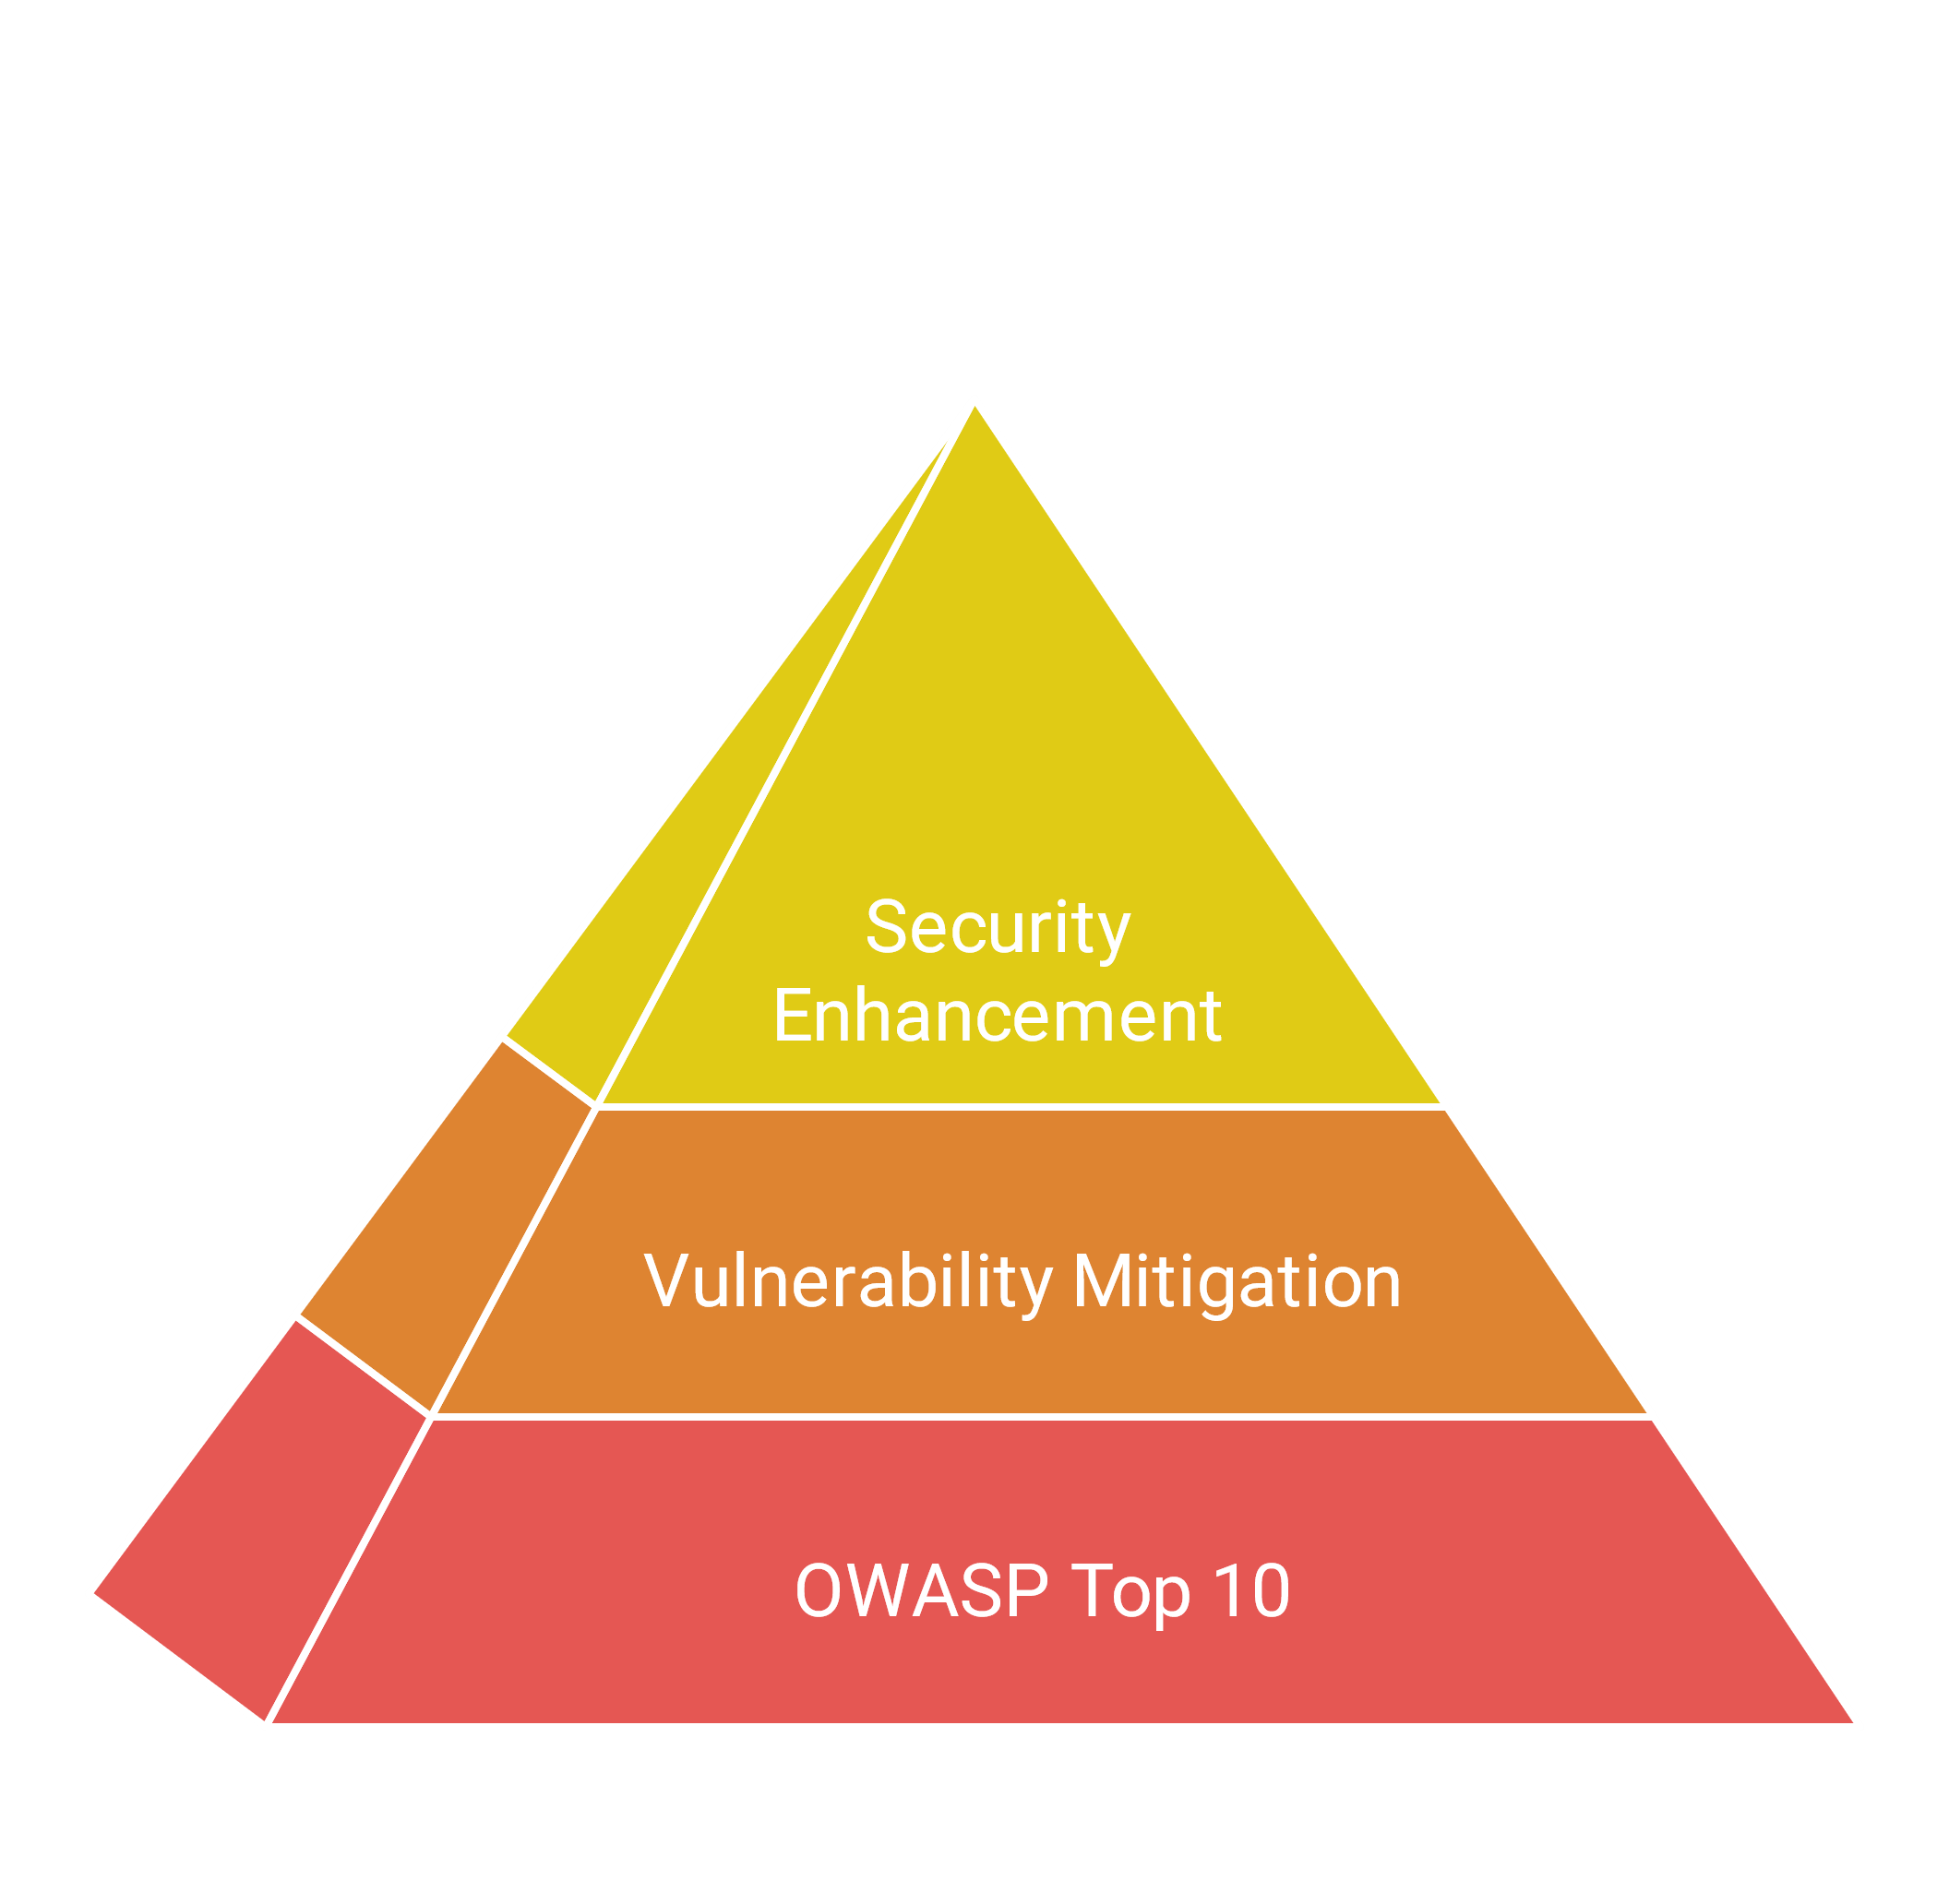
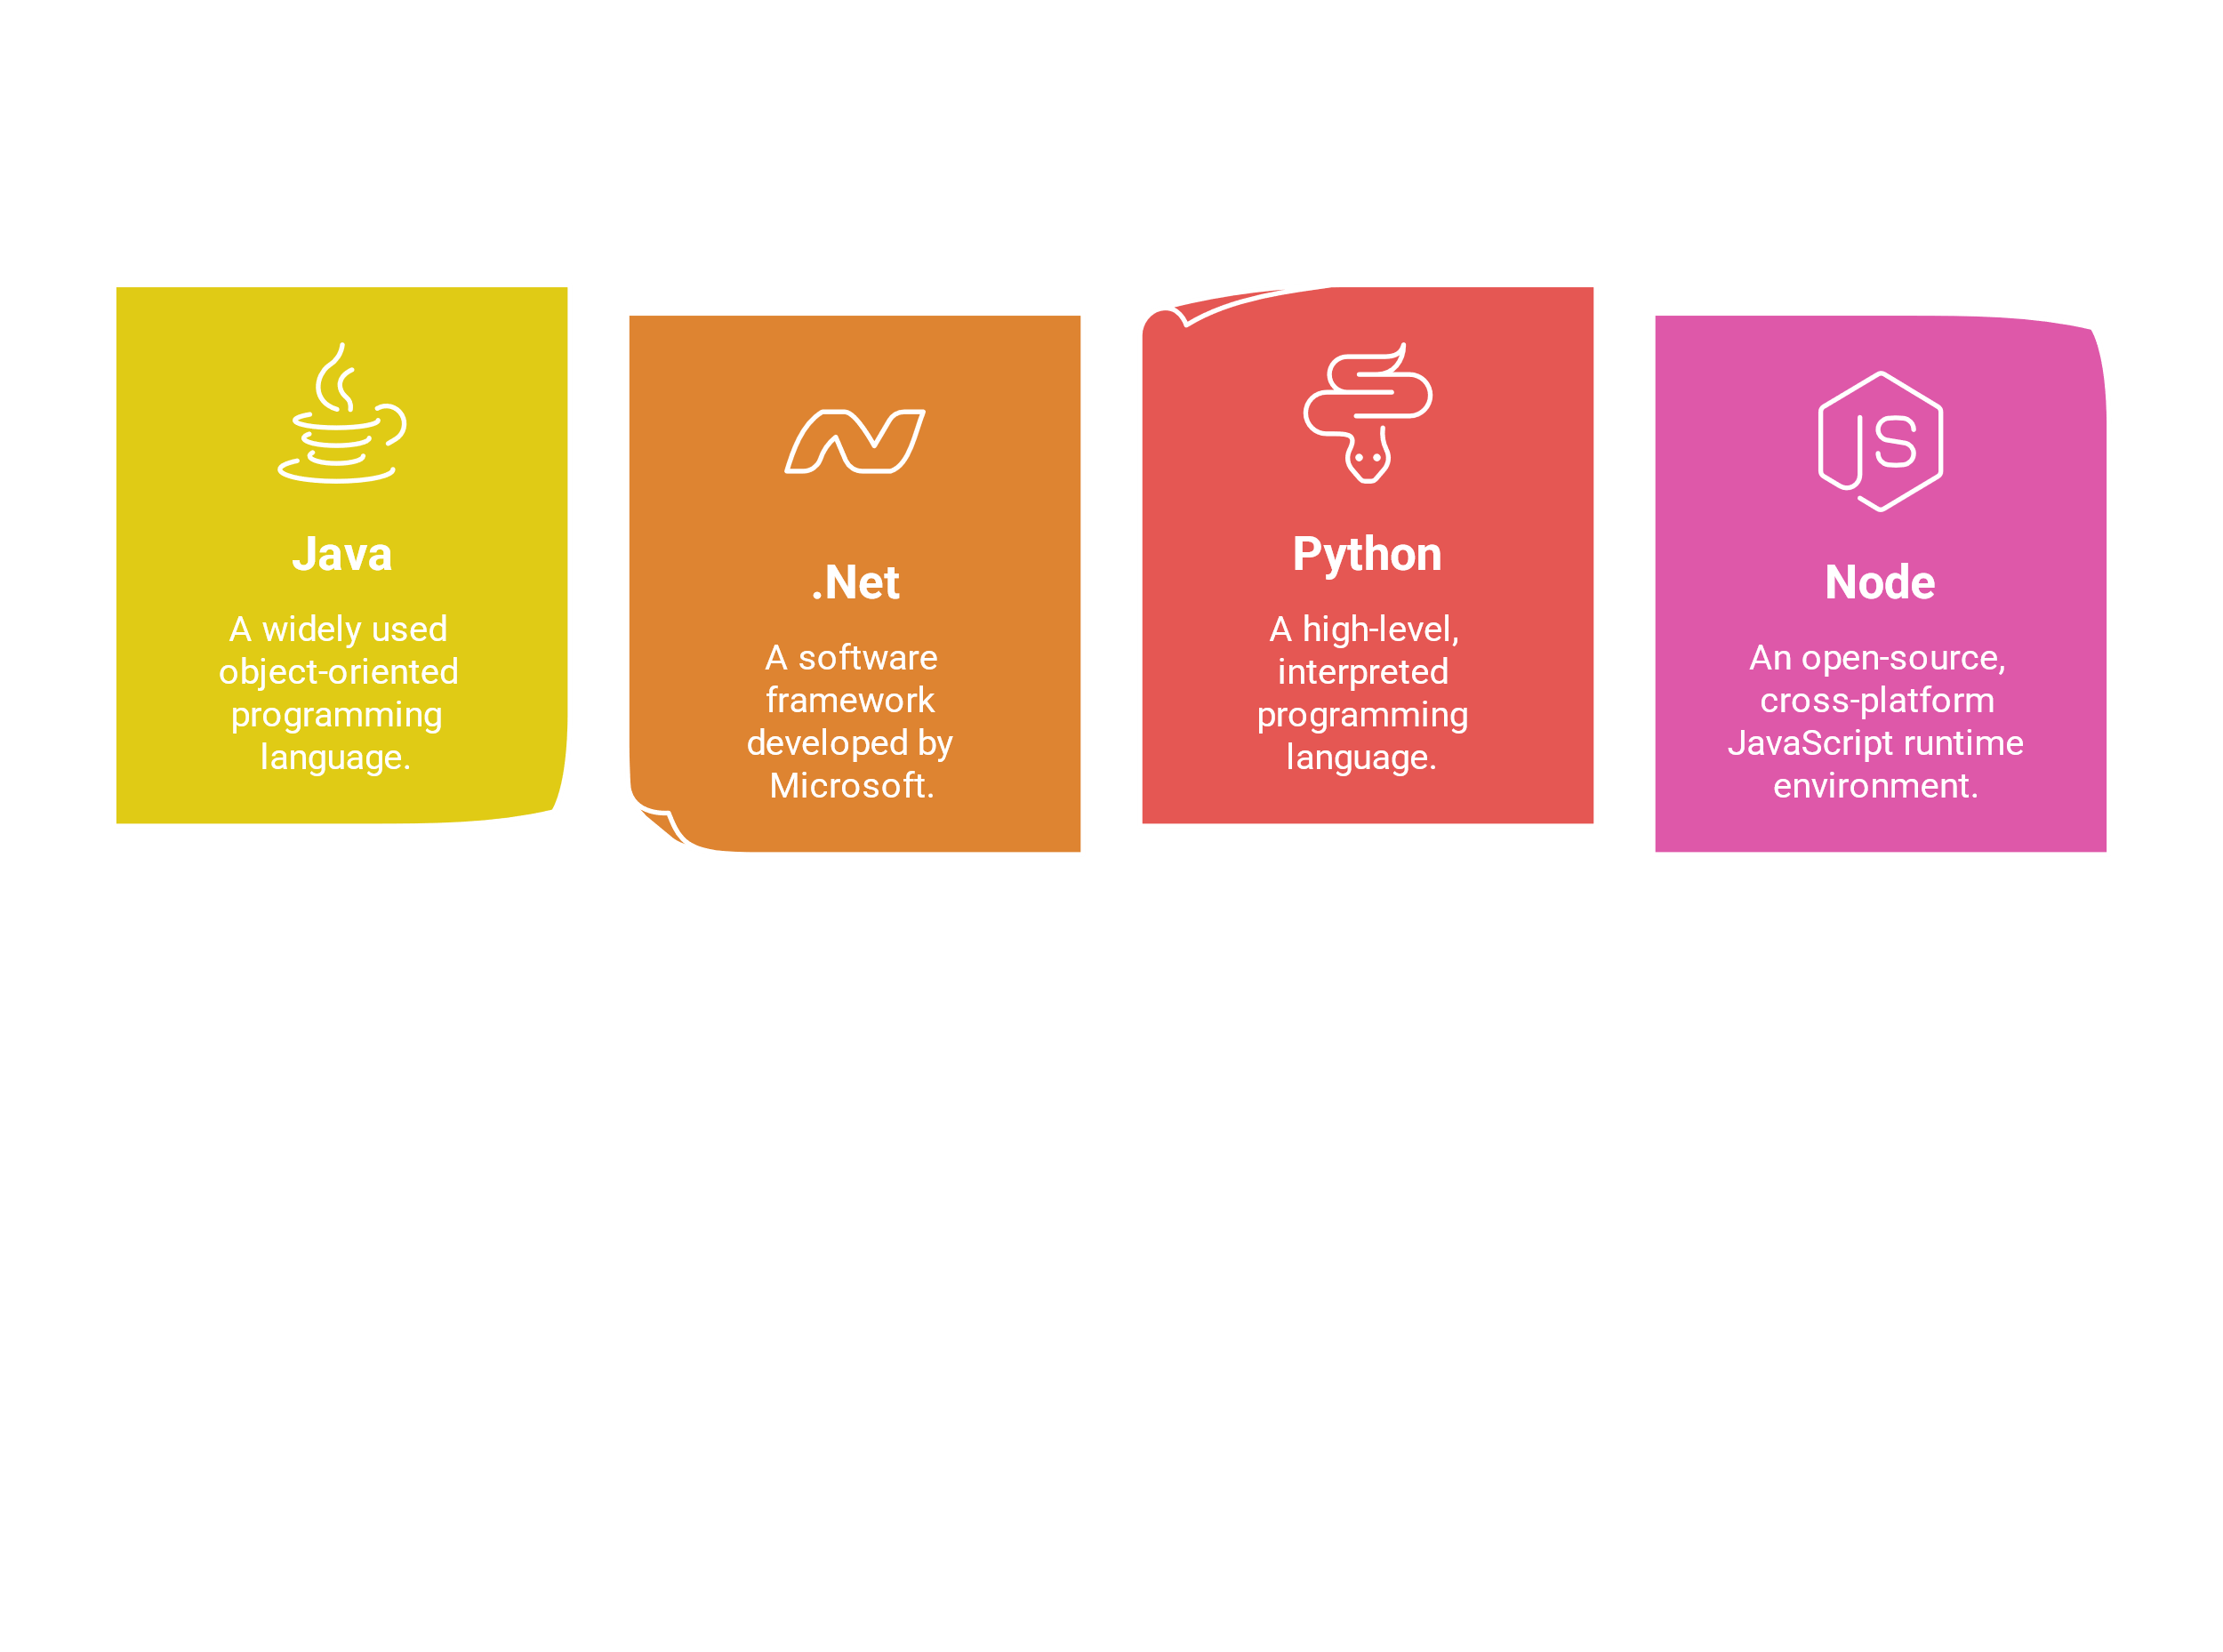
Threat Shielder
Your Application Security Advisor

Slide 2
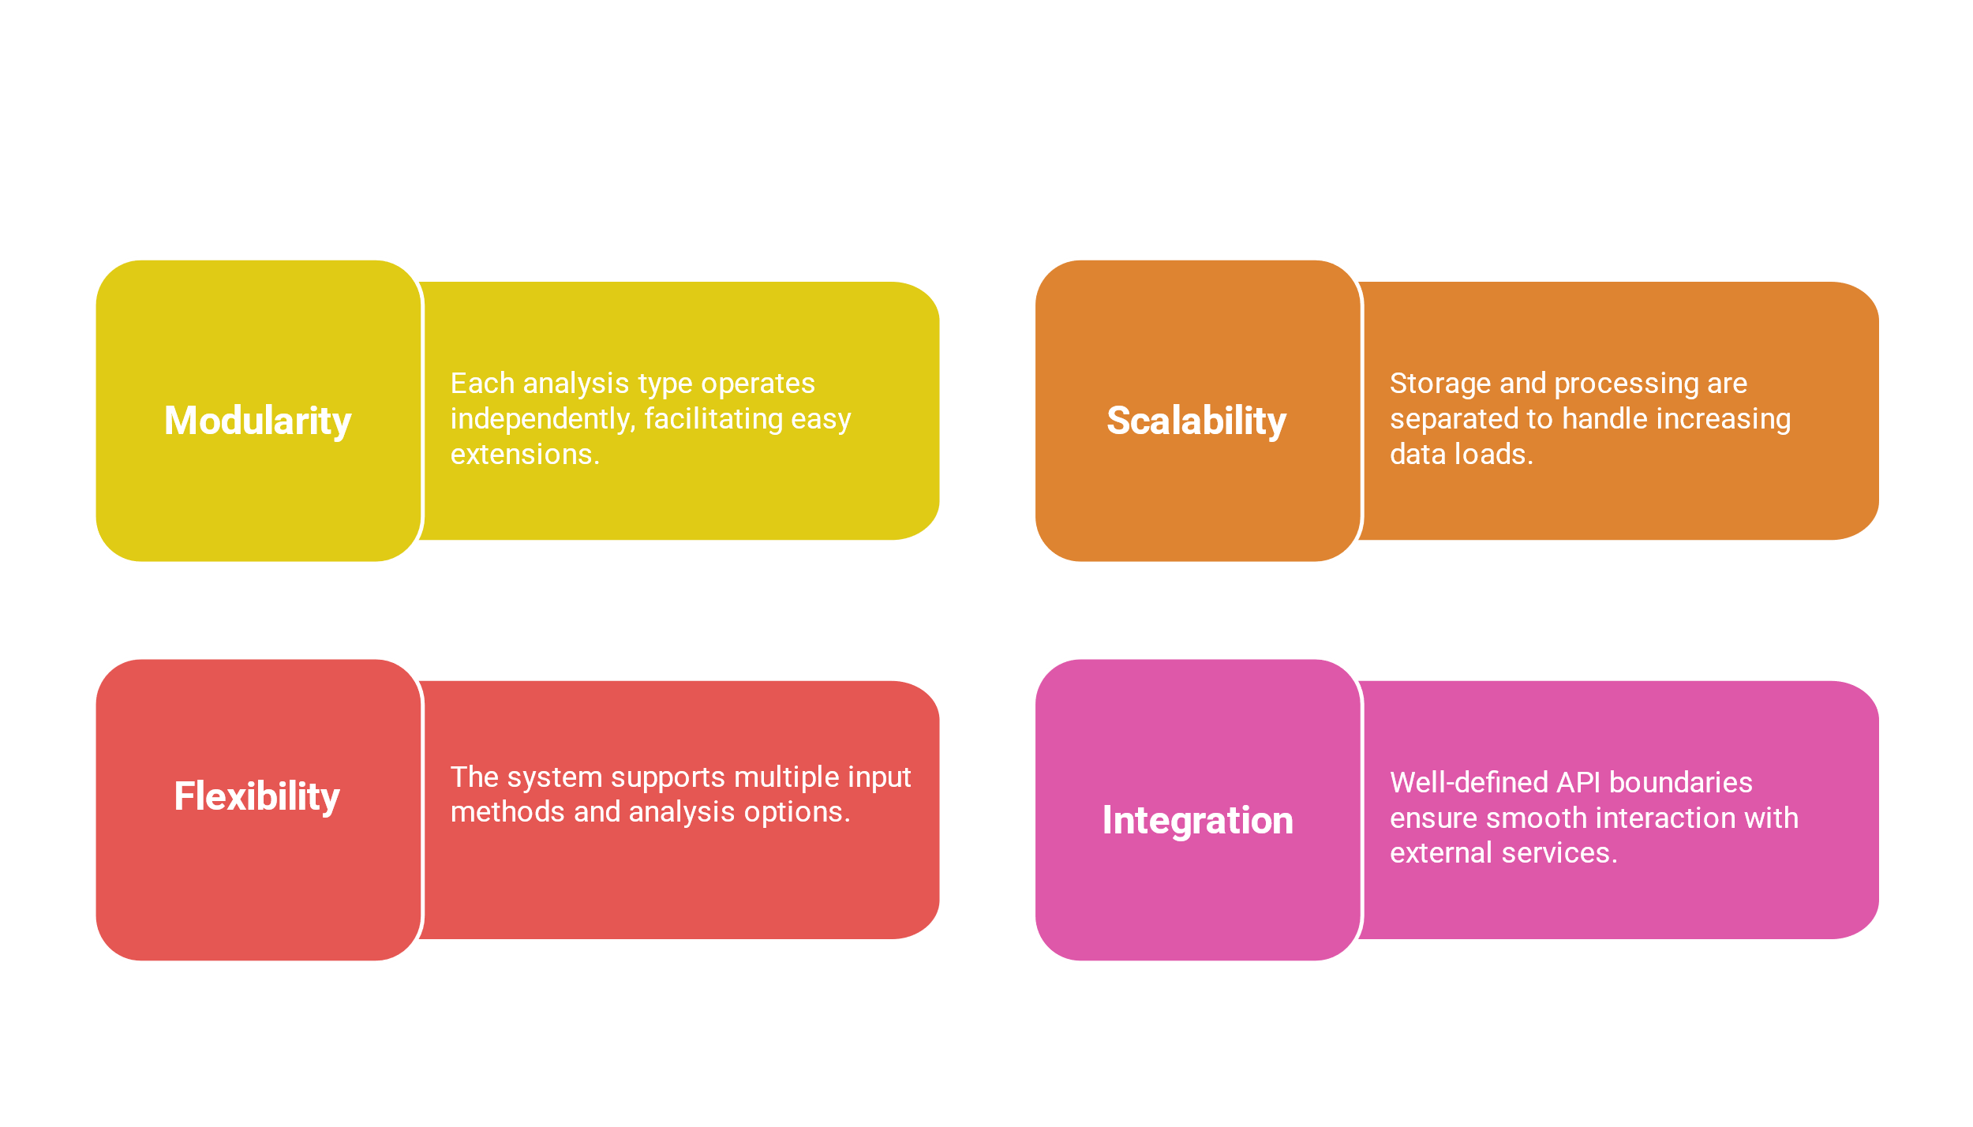
Key Design Considerations Modularity: Each analysis type is independent, allowing for easy extension Scalability: Separate storage and processing layers Flexibility: Multiple input methods and analysis options Integration: Clear API boundaries with external services

Slide 3
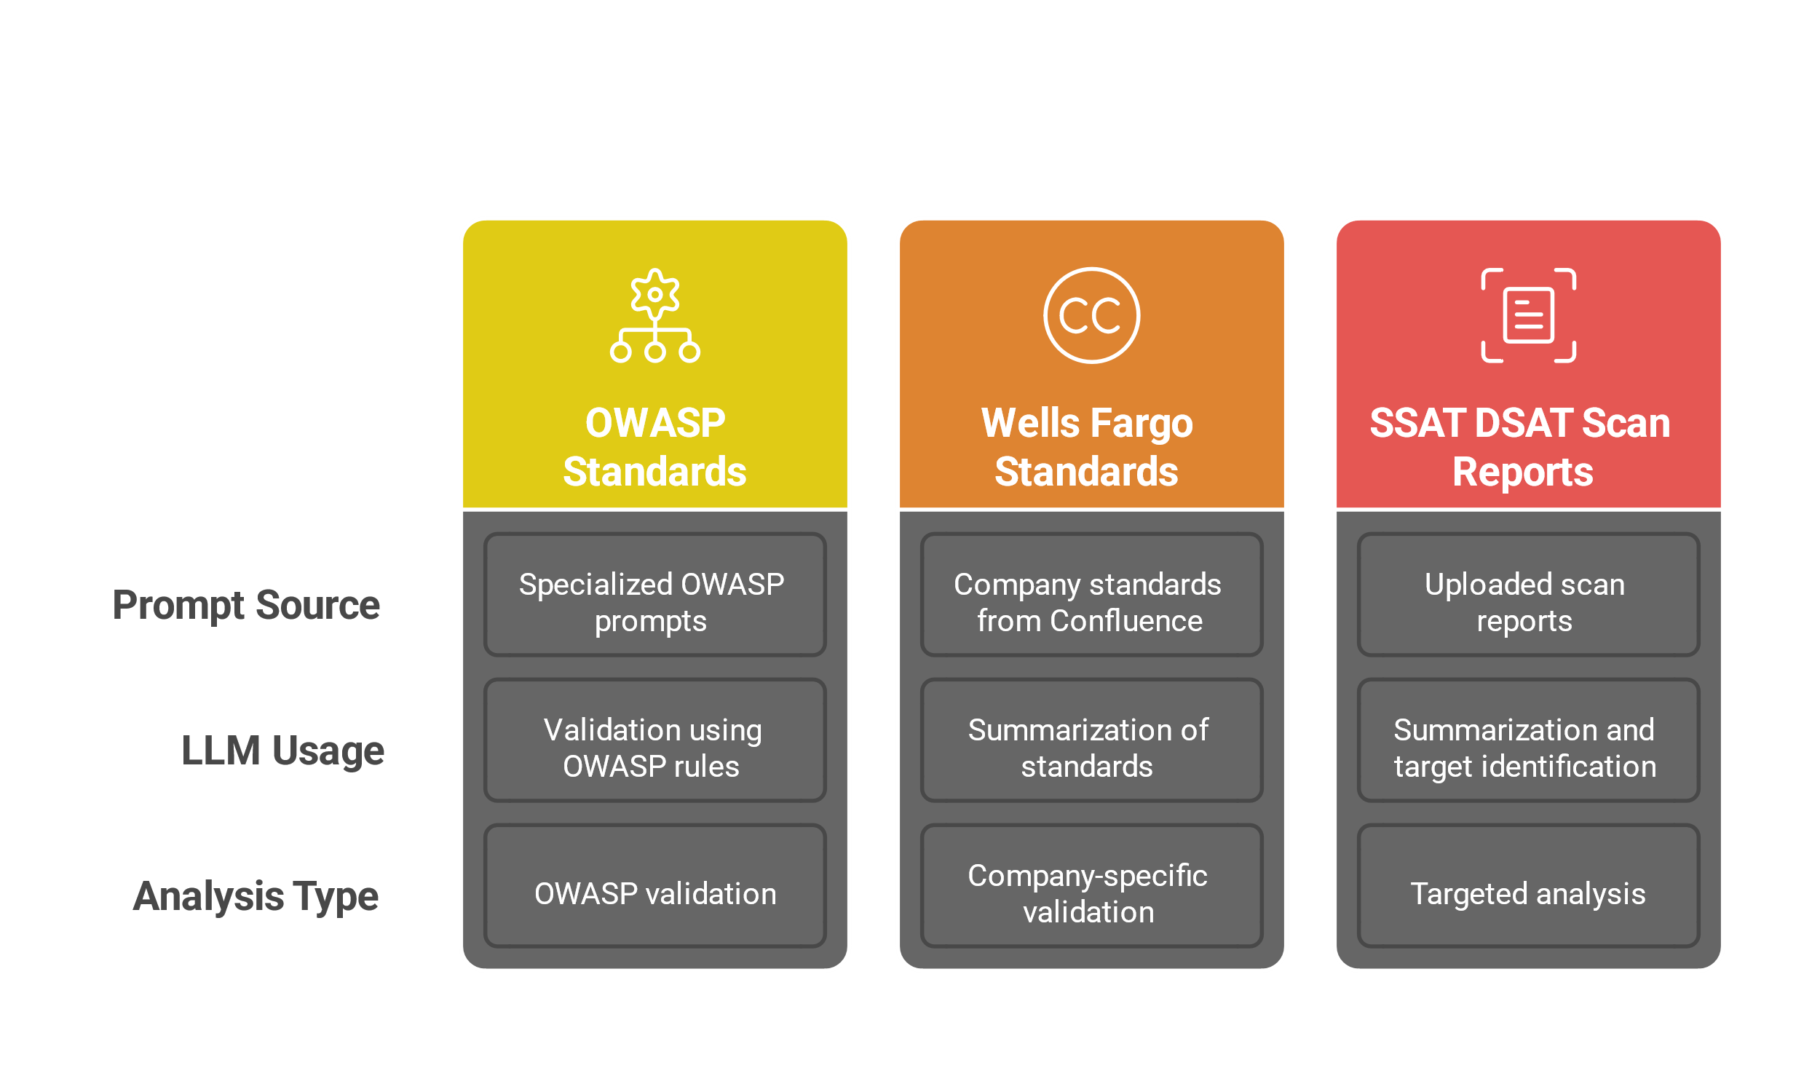
Analysis Engine (Three Analysis Types): OWASP Standards Analysis: Uses specialized OWASP prompts Sends each source file to LLM with OWASP validation rules Company Standards Analysis: Retrieves company standards from Confluence Uses OpenAI to summarize standards Creates specialized prompts for company-specific validation Scan Reports Analysis: Processes uploaded scan reports LLM summarizes reports and identifies target files Performs targeted analysis based on scan findings

Slide 4
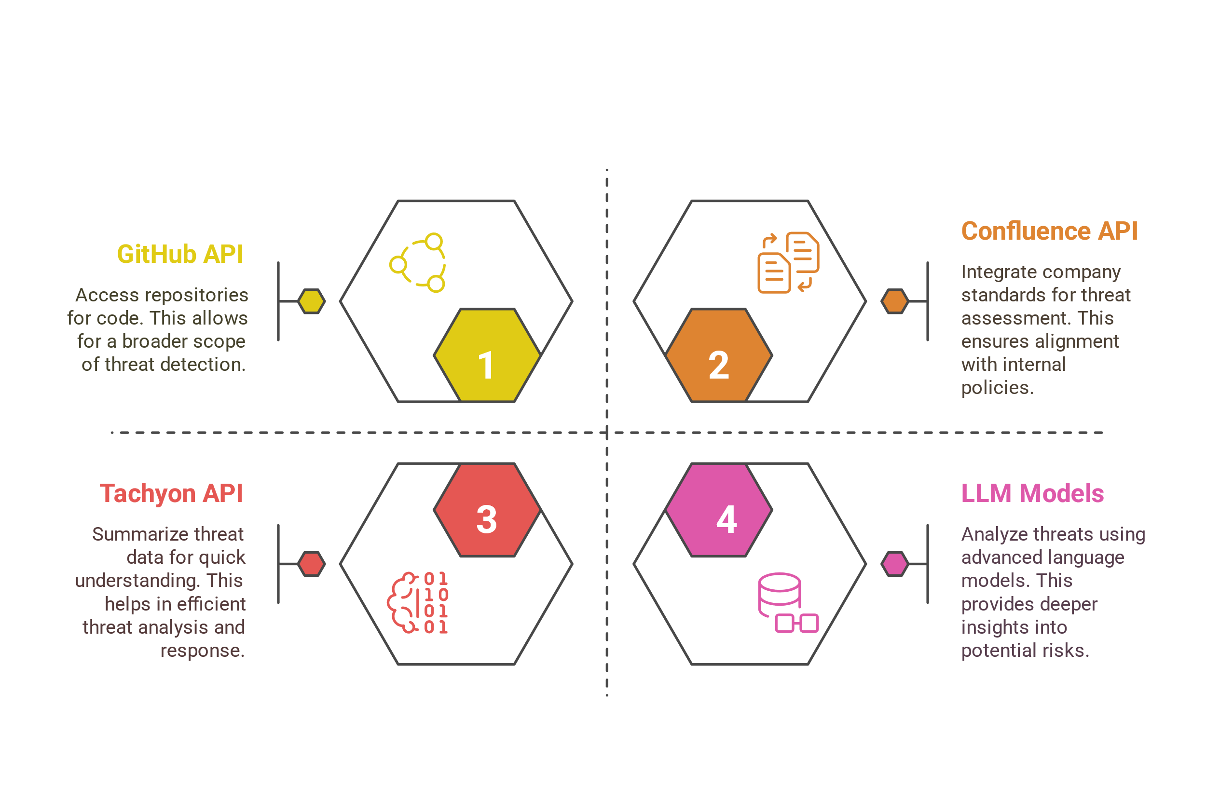
External Dependencies: GitHub API for repository access Confluence API for company standards OpenAI API for summarization LLM service providers for analysis

